Slide 1
Software Testing
Senthil Natarajan
Please Join in below link
LinkedIn: https://www.linkedin.com/company/rba-infotech/
Instagram: https://www.instagram.com/rba_infotech/
Facebook: https://www.facebook.com/people/RBA-Infotech/100043552406579/

Slide 2
What is Software Testing?
The various definitions of Software Testing's are:
Definition 1:
Software testing is the process of evaluating and verifying that a software product or application does what it is supposed to do. The benefits of testing include preventing bugs, reducing development costs and improving performance.
Definition 2:
Software testing is a process, to evaluate the functionality of a software application with an intent to find whether the developed software meets the specified/expected requirements or not and to identify the defects to ensure that the product is defect free in order to produce the quality product.
Definition 3:
Testing is the process of executing a program with the aim of finding errors. To make our software perform well it should be error-free. If testing is done successfully it will remove all the errors from the software

Slide 3
Objective of Testing
• To prevent defects by evaluate work products such as requirements, user stories, design, and code
• To verify whether all specified requirements have been fulfilled
• To check whether the test object is complete and validate if it works as the users and other stakeholders expect
• To build confidence in the level of quality of the test object
• To find defects and failures by reducing the level of risk of inadequate software quality
• To provide sufficient information to stakeholders to allow them to make informed decisions, especially regarding the level of quality of the test object
• To comply with contractual, legal, or regulatory requirements or standards, and/or to verify the test object’s compliance with such requirements or standards

Slide 4
Objective of Testing Continued…
The objectives of testing can vary, depending upon the context of the component or system being tested, the test level, and the software development lifecycle model. These differences may include, for example:
• During component testing, one objective may be to find as many failures as possible so that the underlying defects are identified and fixed early. Another objective may be to increase code coverage of the component tests.
• During acceptance testing, one objective may be to confirm that the system works as expected and satisfies requirements. Another objective of this testing may be to

Slide 5
Testing and Debugging
Testing and debugging are different.
Executing tests can show failures that are caused by defects in the software. Debugging is the development activity that finds, analyzes, and fixes such defects. Subsequent confirmation testing checks whether the fixes resolved the defects.
In some cases, testers are responsible for the initial test and the final confirmation test, while developers do the debugging, associated component and component integration testing.

Slide 6
What is the Impact if Software Testing is not done?
Software will have lot of Defects / Bugs
Loss of Customers
Huge Profit Loss to Business

Slide 7
Testing Principles
The following are the 7 principles of Testing
Testing shows presence of defects
Exhaustive testing is not possible
Early Testing
Defect Clustering
Pesticide Paradox
Testing is context dependant
Absence of errors fallacy

Slide 8
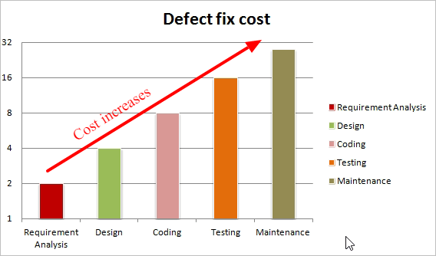
Advantages of Early Testing

Slide 9
Psychology of Testing
Psychology of testing is a type of testing which fully depends on the mindset of developers and tester. When we are building the software, we are working positively towards the working of software, never think about negative things. The mindset should be different while testing and reviewing developing software. With the correct mindset, the programmer can test their own code. At a certain point independence tester often makes the tester more effective to finding defects.

Slide 10
Levels of Independence Tester in Psychology of Testing
Tests designed by the person who wrote the software under test
Tests designed by another person
Tests designed by a person from a different organizational group or test specialists
Tests designed by a person from a different organization or company

Slide 11
STLC or Testing Process
Below are the phases of STLC:
Requirement Analysis
Test Planning
Test Case / Design Development
Test Environment Setup
Test Execution
Test Cycle Closure

Slide 12
Requirement Analysis
During this phase, test team studies the requirements from a testing point of view to identify the testable requirements. The QA team may interact with various stakeholders (Client, Business Analyst, Technical Leads, System Architects etc) to understand the requirements in detail.
Requirements could be either Functional (defining what the software must do) or Non Functional (defining system performance /security availability )
Activities
  Identify types of tests to be performed.
  Gather details about testing priorities and focus.
  Prepare Requirement Traceability Matrix (RTM).
  Identify test environment details where testing is supposed to be carried out.
  Automation feasibility analysis (if required).
Deliverables
  RTM (Requirement Traceability Matrix)
  Automation feasibility report. (if applicable)

Slide 13
Test Planning
Typically, in this stage, a Senior QA manager will determine effort and cost estimates for the project and would prepare and finalize the Test Plan. In this phase, Test Strategy is also determined.
Activities
  Preparation of test plan/strategy document for various types of testing
  Test tool selection
  Test effort estimation
  Resource planning and determining roles and responsibilities.
  Training requirement
Deliverables
  Test Plan document
  Effort estimation document.

Slide 14
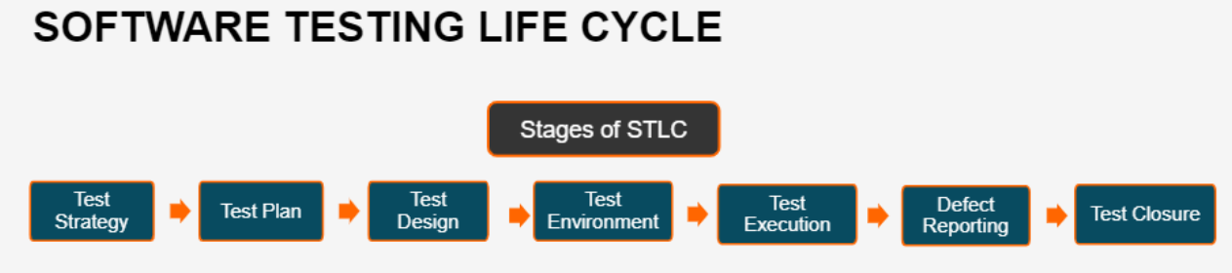
STLC or Testing Process

Slide 15
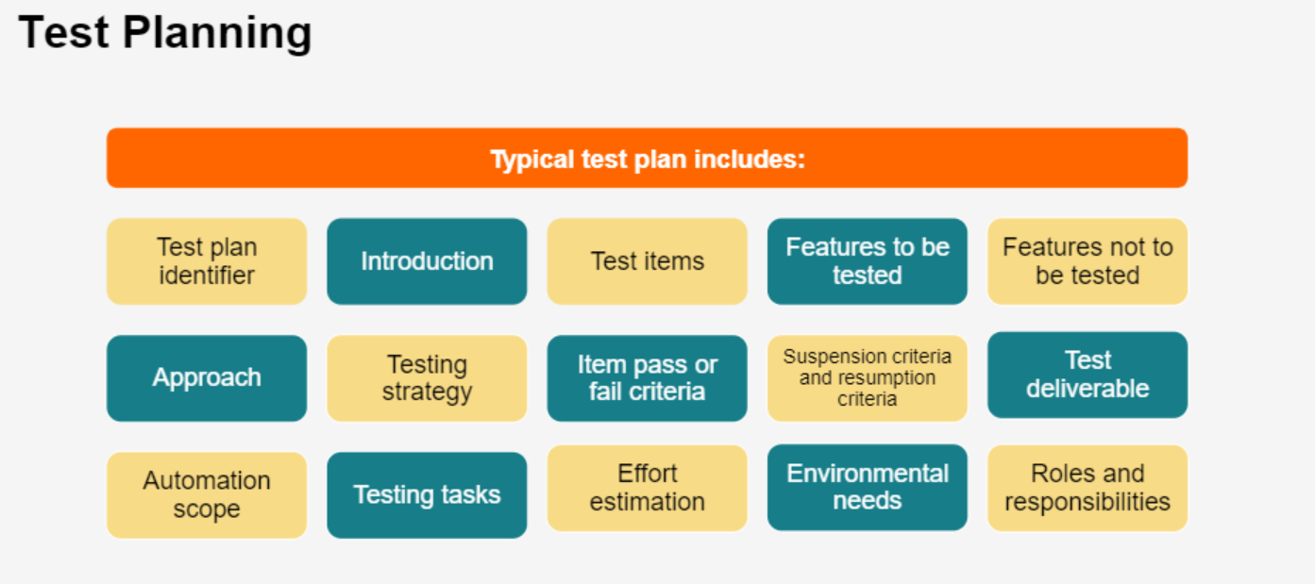
Components of Test Plan

Slide 16
Test Plan Components
Components of Test Plan:
Introduction
Scope of testing
  Features to be tested
  Features not to be tested
  Testing Approach
  Testing Schedule
  Item pass / fail criteria
  Entry and Exit Criteria
  Suspension criteria / resumption criteria
  Test Deliverables

Slide 17
Test Plan Components…
  Testing Tasks
  Effort Estimation
  Roles and Responsibilities
  Resource Planning
  System Resources
  Staffing and Training needs
Risks and Contingencies

Slide 18
Entry and Exit Criteria
STLC Stages | Entry Criteria | Exit Criteria
Requirement Analysis | Requirements Document available (both functional and non functional) Acceptance criteria defined. Application architectural document available | Signed off RTM Test automation feasibility report signed off by the client
Test Planning | Requirements Documents Requirement Traceability matrix. Test automation feasibility document. | Approved test plan/strategy document. Effort estimation document signed off.

Slide 19
Entry and Exit Criteria
STLC Stages | Entry Criteria | Exit Criteria
Test Case Development | Requirements Documents RTM and test plan Automation analysis report | Reviewed and signed test cases/scripts Reviewed and signed test data
Test Environment Setup | System Design and architecture documents are available Environment set-up plan is available | Environment setup is working as per the plan and checklist Test data setup is complete Smoke test is successful
Test Execution | Baselined RTM, Test Plan , Test case/scripts are available Test environment is ready Test data set up is done Unit/Integration test report for the build to be tested is available | All tests planned are executed Defects logged and tracked to closure

Slide 20
Entry and Exit Criteria
STLC Stages | Entry Criteria | Exit Criteria
Test Cycle closure | Testing has been completed Test results are available Defect logs are available | Test Closure report signed off by client

Slide 21
Test Strategy
The Test strategy document is a high-level document that outlines the testing technique used in the Software Development Life Cycle and confirms the test kinds or levels that will be performed on the product. One can’t change the test strategy once it’s been written, and it’s been accepted by the Project Manager and development team.
In addition, the test strategy provides the following details, which are required while writing the test document:
What technique must be used in addition to this?
Which of the modules will be examined?
What criteria apply for entry and exit?
What kind of testing is necessary?

Slide 22
Test Approach
Test Approach
A test approach is the test strategy implementation of a project, defines how testing would be carried out.
Test approach has two techniques:
Proactive - An approach in which the test case design process is initiated as early as possible in order to find and fix the defects before the build is created.
Reactive - An approach in which the testing is not started until after design and coding are completed.

Slide 23
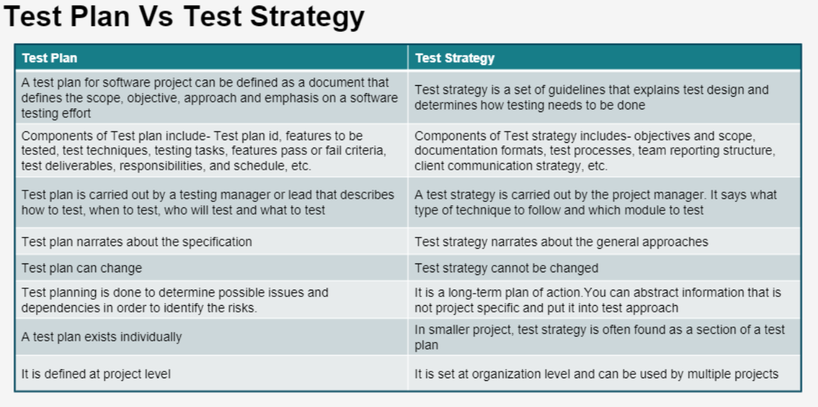
Test Plan vs Test Strategy

Slide 24
Test Plan vs Test Strategy
Parameter | Test Plan | Test Strategy
Definition | A test plan is a document that encompasses the scope and different activities involved in the testing process. | A test strategy is a high-level document that encompasses guidelines and principles involved in carrying out the testing process.
Goal | The primary goal here is to define how to test a product, what to test it on when to test it, who will test, and who will verify the results. | Here, the primary goal is to define the principles to be followed during the testing process.
Components | Its components include Introduction Features to be tested Features not to be tested Test Approach Roles and responsibility Schedule Bug tracking Entry and exit criteria Test automation Effort estimation, Test deliverables Assumption Risk Mitigation plan Templets | Its components include – Objective and Scope Testing tools Testing metrics Requirement Traceability Matrix Training plan Documentation Formats Testing Process Business issues Team Reporting Structure Client Communication Strategy Test summary

Slide 25
Test Plan vs Test Strategy
Parameter | Test Plan | Test Strategy
Performed by | Usually, a testing manager or lead creates a test plan that outlines how to test, when to test, who will test, and what will be tested. | A test strategy is developed by the project manager as part of the testing process. The document specifies what type of technique to use and which modules should be tested.
Scope | It thoroughly defines the whole testing activities. | It only focuses on high-level test methods and strategies.
Level | It is used on a project level only. | It is used on an organizational level.
Repetition | It is used by one project only and is very rarely repeated. | It is used by multiple projects and can be repeated a lot of times.
Change Susceptibility | It is a dynamic document and can be changed repeatedly depending on testing specifications. | It can not be changed since it is a static document.

Slide 26
Test Case Development
This phase involves the creation, verification and rework of test cases & test scripts. Test data, is identified/created and is reviewed and then reworked as well.
Activities
  Create test cases, automation scripts (if applicable)
  Review and baseline test cases and scripts
  Create test data (If applicable)
Deliverables
  Test cases/scripts
  Test data

Slide 27
Test Environment Setup
Test environment decides the software and hardware conditions under which a work product is tested. Test environment set-up is one of the critical aspects of testing process and can be done in parallel with Test Case Development Stage. Test team may not be involved in this activity if the customer/development team provides the test environment in which case the test team is required to do a readiness check (smoke testing) of the given environment.
Activities
  Understand the required architecture, environment set-up and prepare hardware and software requirement list for the Test Environment.
  Setup test Environment and test data
  Perform smoke test on the build
Deliverables
  Environment ready with test data set up
  Smoke Test Results.

Slide 28
Test Execution
During this phase, the testers will carry out the testing based on the test plans and the test cases prepared. Bugs will be reported back to the development team for correction and retesting will be performed.
Activities
  Execute test cases as per plan
  Document test results, and log defects for failed cases
  Map defects to test cases in RTM
  Retest the Defect fixes
  Track the defects to closure
Deliverables
  Completed RTM with the execution status
  Test cases updated with results
  Defect reports

Slide 29
Test Cycle Closure
Testing team will meet, discuss and analyse the testing artifacts to identify strategies that have to be implemented in the future, taking lessons from the current test cycle. The idea is to remove the process of bottlenecks for future test cycles and share best practices for any similar projects in the future.
Activities
  Evaluate cycle completion criteria based on Time, Test coverage, Cost, Software, Critical Business Objectives and Quality
  Prepare test metrics based on the above parameters.
  Document the learning out of the project
  Prepare Test closure report
  Qualitative and quantitative reporting of quality of the work product to the customer.
  Test result analysis to find out the defect distribution by type and severity.
Deliverables
  Test Closure report
  Test metrics

Slide 30
Roles and Responsibility of Tester
Understanding Test Requirements
Deriving Test Scenarios
Designing Test Cases
Updating Traceability Matrix Document
Creating / Collecting Test Data
Executing Test Cases
Reporting Defects and Tracking Defects
Collecting Test Metrics
Updating Test Cases (If Required)
Contributing in Test Plan Preparation

Slide 31
Quality Assurance vs Quality Control
Quality Assurance | Quality Control
QA is the implementation of processes, methodologies and standards that ensure that the software developed will be up to the required quality standards. | QC is the set of activities that are carried out to verify the developed product meets the required standards.
QA focuses on the improvement of process and methodologies used to develop product. | QC focuses on the improvement of the product by identifying the bugs and issues.
It is process oriented. | It is product oriented.
QA aim is to prevent the defect. | QC aim is to identify and improve the defects.
QA is the technique of managing quality. | QC is a method to verify quality.

Slide 32
Test Case Development / Design

Slide 33
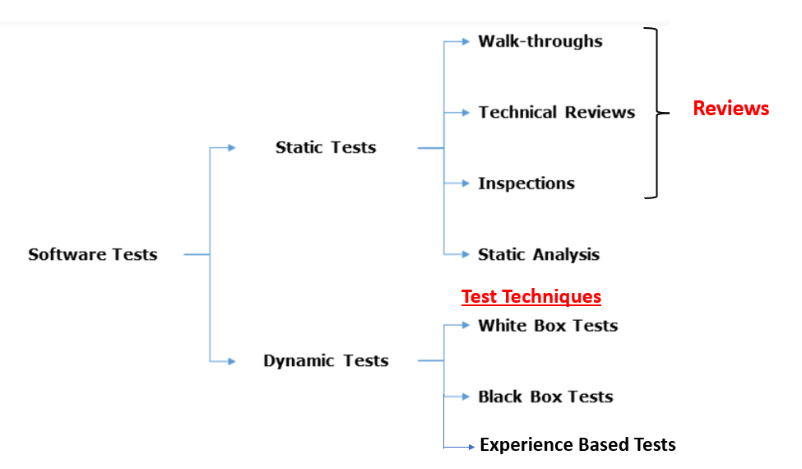
Software Testing Technique

Slide 34
What is Static Testing?
In contrast to dynamic testing, which requires the execution of the software being tested, static testing relies on the manual examination of work products (i.e., reviews) or tool-driven evaluation of the code or other work products (i.e., static analysis). Both types of static testing assess the code or other work product being tested without actually executing the code or work product being tested.

Slide 35
Work Products that Can Be Examined by Static Testing
In Static Testing, the following work products are tested
• Specifications, including business requirements, functional requirements, and security requirements
• Epics, user stories, and acceptance criteria
• Architecture and design specifications
• Code
• Testware, including test plans, test cases, test procedures, and automated test scripts
• User guides
• Web pages
• Contracts, project plans, schedules, and budget planning
• Configuration set up and infrastructure set up
• Models, such as activity diagrams, which may be used for Model-Based testing (see ISTQBCTFL-MBT and Kramer 2016)

Slide 36
Why Static Testing?
Early defect detection and correction
Reduced development cost and time
Reduced testing cost and time
For improvement of development productivity
To get fewer only defect at a later stage of testing
Automated tools can expedite the code and document review process.
Static testing can also boost the amount of communication between teams.

Slide 37
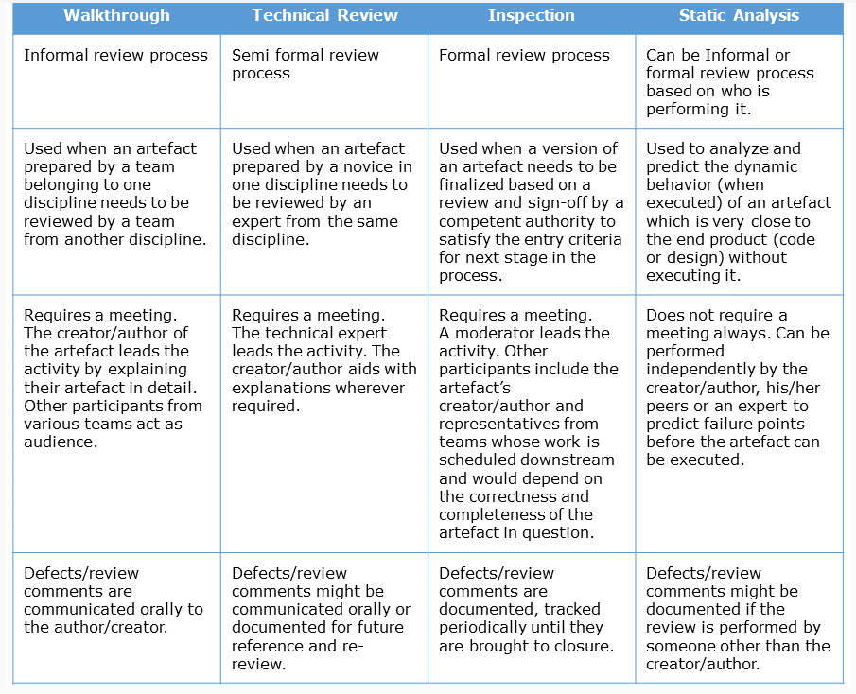
Review Types and Static Analysis

Slide 38
Reviews
A review is a systematic examination of a documents by one or more people with the main aim of finding and removing errors early in the software development life cycle. Reviews are used to verify documents such as requirements, system designs, code, test plans and test cases.
The Review Process:
The phases of the Review Processes are
Planning
Kick-Off
Preparation
Review Meeting
Rework
Follow-Up

Slide 39
Reviews Technique
There are number of review techniques which can be used during review. The below are the Review Techniques
Ad hoc Review
Checklist-Based Review
Scenarios and Dry Run Review
Perspective Based Review
Role Based Review

Slide 40
Static Analysis
Static Analysis includes the evaluation of the code quality that is written by developers with the help of the tools. Different tools are used to do the static analysis of the code and comparison of the same with the standard.
It also helps in identifying the following defects
Unused Variables
Dead Code
Infinite Loop
Variable with undefined value
Wrong Syntax

Slide 41
Tools Used for Static Testing
The following tools are used for Static Testing
SonarQube – it is one of the best tool in the industry.
Checkstyle
Soot
SourceMeter

Slide 42
Dynamic Test Techniques
Black Box Test Technique
White Box Test Technique
Experience Based Test Technique
Black Box Test Technique:
    Black Box Testing is a Software Testing method that analyses the functionality of a software/application without knowing much about the internal structure/design of the item that is being tested and compares the input value with the output value.
    Black Box Testing is also known as behavioural, opaque-box, closed-box, specification-based or eye-to-eye testing.
    The main focus in Black Box Testing is on the functionality of the system as a whole.

Slide 43
Dynamic Test Techniques…
    White Box Test Technique:
  White Box Testing is based on the knowledge about the internal logic and structure of an application code.
  It is also known as Structure Based Testing or Glass box Testing. Internal software and code working should be known for performing this type of testing. Under these tests are based on the coverage of code statements, branches, paths, conditions, etc.
  Experience Based Test Technique:
Experience-based test techniques leverage the experience of developers, testers and users to design, implement, and execute tests. These techniques are often combined with black-box and white-box test techniques.

Slide 44
Types of Black Box Test Techniques
Equivalence Partitioning
Boundary Value Analysis
Decision Table
State Transition Diagram
Use Case Testing

Slide 45
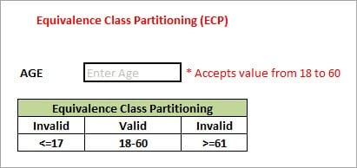
Equivalence Partitioning
This technique is also known as Equivalence Class Partitioning (ECP). In this technique, input values to the system or application are divided into different classes or groups based on its similarity in the outcome.
Hence, instead of using each and every input value we can now use any one value from the group/class to test the outcome. In this way, we can maintain the test coverage while we can reduce a lot of rework and most importantly the time spent.

Slide 46
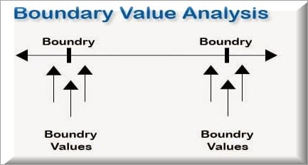
Boundary Value Analysis
From the name itself, we can understand that in this technique we focus on the values at boundaries as it is found that many applications have a high amount of issues on the boundaries.
Boundary means the values near the limit where the behaviour of the system changes. In boundary value analysis both the valid inputs and invalid inputs are being tested to verify the issues.
If we want to test a field where values from 1 to 100 should be accepted then we choose the boundary values: 1-1, 1, 1+1, 100-1, 100, and 100+1. Instead of using all the values from 1 to 100, we just use 0, 1, 2, 99, 100, and 101.

Slide 47
Decision Table Testing
As the name itself suggests that, wherever there are logical relationships like:
If
{
(Condition1 = True && Condition2 = True)
then action1 ;
}
else action2; /*(Either the conditions = False)*/
Then a tester will identify two outputs (action1 and action2) for two conditions (True and False). So based on the probable scenarios a Decision table is carved to prepare a set of test cases.
For Example:
Take an example of XYZ bank that provides interest rate for the Male senior citizen as 10% and for the rest of the people 9%.

Slide 48
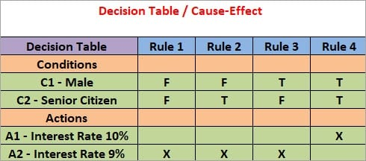
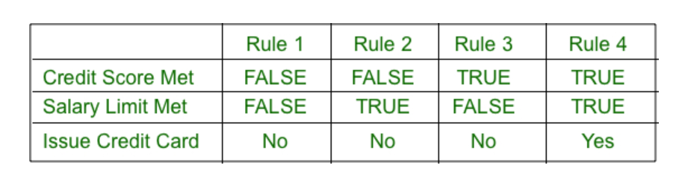
Decision Table Testing
Ex: 1
Ex: 2

Slide 49
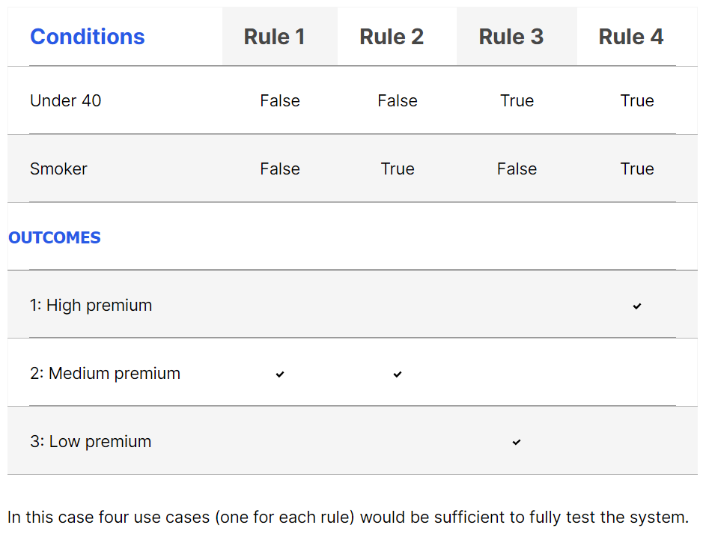
Decision Table Testing
For example, a health insurance company may provide different premium based on the age of the insured person (under 40 or over 40) and whether they are a smoker or not. This generates a decision table with four rules and up to four outcomes—below is an example with three possible outcomes.
Ex: 3

Slide 50
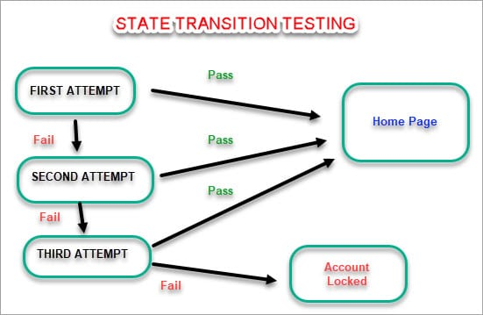
State Transition Testing
State Transition Testing is a technique that is used to test the different states of the system under test. The state of the system changes depending upon the conditions or events. The events trigger states which become scenarios and a tester needs to test them.
A systematic state transition diagram gives a clear view of the state changes but it is effective for simpler applications. More complex projects may lead to more complex transition diagrams thus making it less effective.

Slide 51
Use Case Testing
A use case is a graphical representation of actions that describes the behavior of a system to do a particular task. Tests can be derived from use cases, which are a specific way of designing interactions with software items. They incorporate requirements for the software functions. Use cases are associated with actors (human users, external hardware, or other components or systems) and subjects (the component or system to which the use case is applied).
Coverage can be measured by the number of use case behaviors tested divided by the total number of use case behaviors, normally expressed as a percentage.

Slide 52
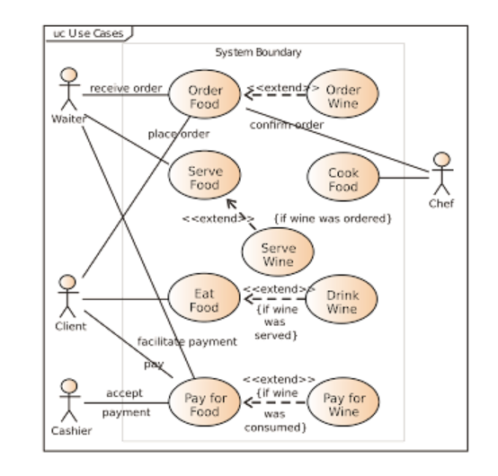
Use Case Testing…

Slide 53
White Box Test Techniques
White Box Testing is software testing technique in which internal structure, design and coding of software are tested to verify flow of input-output and to improve design, usability and security. In white box testing, code is visible to testers so it is also called Clear box testing, Open box testing, Transparent box testing, Code-based testing and Glass box testing.
The following are different Test Technique in White Box Test Technique
Statement Testing Coverage
Decision Testing Coverage
The Value of Statement and Decision Testing

Slide 54
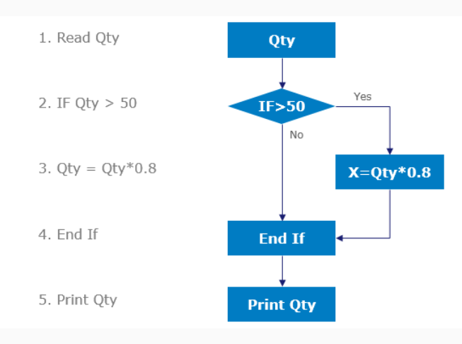
Statement Testing and Coverage
Statement testing exercises the potential executable statements in the code. Coverage is measured as the number of statements executed by the tests divided by the total number of executable statements in the test object, normally expressed as a percentage.

Slide 55
Decision Testing and Coverage
Decision testing exercises the decisions in the code and tests the code that is executed based on the decision outcomes. To do this, the test cases follow the control flows that occur from a decision point (e.g., for an IF statement, one for the true outcome and one for the false outcome; for a CASE statement, test cases would be required for all the possible outcomes, including the default outcome).
Coverage is measured as the number of decision outcomes executed by the tests divided by the total number of decision outcomes in the test object, normally expressed as a percentage.

Slide 56
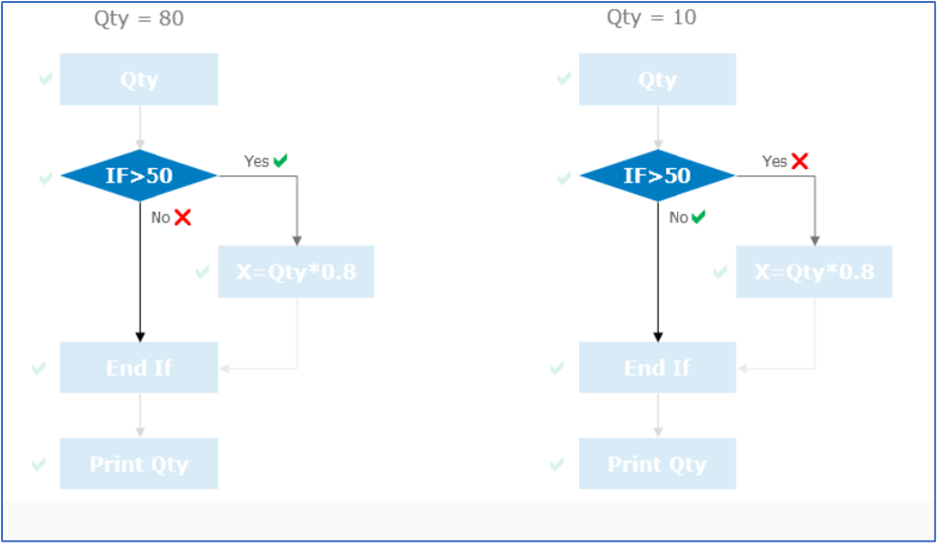
Decision Testing and Coverage

Slide 57
The Value of Statement and Decision Testing
When 100% statement coverage is achieved, it ensures that all executable statements in the code have been tested at least once, but it does not ensure that all decision logic has been tested. Of the two Whitebox techniques discussed in this syllabus, statement testing may provide less coverage than decision testing.
When 100% decision coverage is achieved, it executes all decision outcomes, which includes testing the true outcome and also the false outcome, even when there is no explicit false statement (e.g., in the case of an IF statement without an else in the code). Statement coverage helps to find defects in code that was not exercised by other tests. Decision coverage helps to find defects in code where other tests have not taken both true and false outcomes.

Slide 58
Statement Coverage and Decision Coverage
Achieving 100% decision coverage guarantees 100% statement coverage (but not vice versa).
Ref: https://stackoverflow.com/questions/14519416/a-difference-between-statement-and-decision-coverage
Example:
if(a || b)) {
test1 = true;
}
else {
if(c) {
test2 = true
}
}
statement coverage have to test each statement at least once, so we need just two tests:
  a=true b=false - that gives us path if(a||b) true -> test1 = true
  a=false, b=false and c=true - that gives us path: if(a||b) false -> else -> if(c) -> test2=true.
This way we executed each and every statement

Slide 59
Statement Coverage and Decision Coverage
branch/decision coverage needs one more test:
  a=false, b=false, c=false - that leads us to that second if but we are executing false branch from that statement, that wasn't executed in statement coverage
That way we have all the branches tested, meaning we went through all the paths.

Slide 60
Experience Based Test Technique
When applying experience-based test techniques, the test cases are derived from the tester’s skill and intuition, and their experience with similar applications and technologies. These techniques can be helpful in identifying tests that were not easily identified by other more systematic techniques. Depending on the tester’s approach and experience, these techniques may achieve widely varying degrees of coverage and
Types of Experience Based Test Technique
Error Guessing
Exploratory Testing
Checklist Based Testing

Slide 61
1. Error Guessing
Error guessing is a technique used to anticipate the occurrence of errors, defects, and failures, based on the tester’s knowledge, including:
• How the application has worked in the past
• What kind of errors tend to be made
• Failures that have occurred in other applications
A methodical approach to the error guessing technique is to create a list of possible errors, defects, and failures, and design tests that will expose those failures and the defects that caused them. These error, defect, failure lists can be built based on experience, defect and failure data, or from common knowledge about why software fails.

Slide 62
Exploratory Testing
In exploratory testing, informal (not pre-defined) tests are designed, executed, logged, and evaluated dynamically during test execution. The test results are used to learn more about the component or system, and to create tests for the areas that may need more testing.
Exploratory testing is sometimes conducted using session-based testing to structure the activity. In session-based testing, exploratory testing is conducted within a defined time-box, and the tester uses a test charter containing test objectives to guide the testing. The tester may use test session sheets to document the steps followed and the discoveries made.
Exploratory testing is most useful when there are few or inadequate specifications or significant time pressure on testing. Exploratory testing is also useful to complement other more formal testing techniques.

Slide 63
Checklist Based Testing
In checklist-based testing, testers design, implement, and execute tests to cover test conditions found in a checklist. As part of analysis, testers create a new checklist or expand an existing checklist, but testers may also use an existing checklist without modification. Such checklists can be built based on experience, knowledge about what is important for the user, or an understanding of why and how software fails.
Checklists can be created to support various test types, including functional and non-functional testing. In the absence of detailed test cases, checklist-based testing can provide guidelines and a degree of consistency. As these are high-level lists, some variability in the actual testing is likely to occur, resulting in potentially greater coverage but less repeatability.

Slide 64
Test Execution

Slide 65
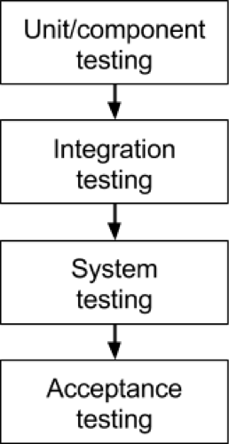
Different Testing Level / Stage

Slide 66
Unit / Component Testing
The most basic type of testing is unit, or component, testing.
Unit testing aims to verify each part of the software by isolating it and then perform tests to demonstrate that each individual component is correct in terms of fulfilling requirements and the desired functionality.
This type of testing is performed at the earliest stages of the development process, and in many cases it is executed by the developers themselves before handing the software over to the testing team.

Slide 67
Integration Testing
Integration testing is done after combining or integrating the difference units, components and modules and verify if the data flow between them works correctly.
There are two types of Integration Testing
  Unit Integration Testing
  System Integration Testing
There are many ways to test how different components of the system function at their interface; testers can adopt any of the below method
Top-down Approach
Bottom-up Approach
Hybrid Approach
Big Bang Approach

Slide 68
System Testing
The next level of testing is system testing. As the name implies, all the components of the software are tested as a whole in order to ensure that the overall product meets the requirements specified.
System testing is a very important step as the software is almost ready to ship and it can be tested in an environment which is very close to that which the user will experience once it is deployed.
System testing enables testers to ensure that the product meets business requirements, as well as determine that it runs smoothly within its operating environment. This type of testing is typically performed by a specialized testing team.

Slide 69
User Acceptance Testing
Finally, acceptance testing is the level in the software testing process where a product is given the green light or not. The aim of this type of testing is to evaluate whether the system complies with the end-user requirements and if it is ready for deployment.
The testing team will utilise a variety of methods, such as pre-written scenarios and test cases to test the software and use the results obtained from these tools to find ways in which the system can be improved.
The scope of acceptance testing ranges from simply finding spelling mistakes and cosmetic errors, to uncovering bugs that could cause a major error in the application.
By performing acceptance tests, the testing team can find out how the product will perform when it is installed on the user’s system. There are also various legal and contractual reasons why acceptance testing has to be carried out.

Slide 70
User Acceptance Testing
Two Types of Acceptance Testing
Alpha Testing
Beta Testing
Alpha Testing | Beta Testing
It is done by internal testers of the organization. | It is done by real users or clients who are not part of the organization.
Alpha testing is performed at the developer’s site. | Beta testing is performed at the end-user of the product.
Alpha Testing uses both black box and white box testing techniques | Beta Testing only uses the black box testing technique.
The main goal is to evaluate the quality of the product | The main goal is to evaluate customer satisfaction.
Developers can resolve the bugs in alpha testing after testers inform them. | The feedback collected from the users is implemented in the future or in the next version of the application.

Slide 71
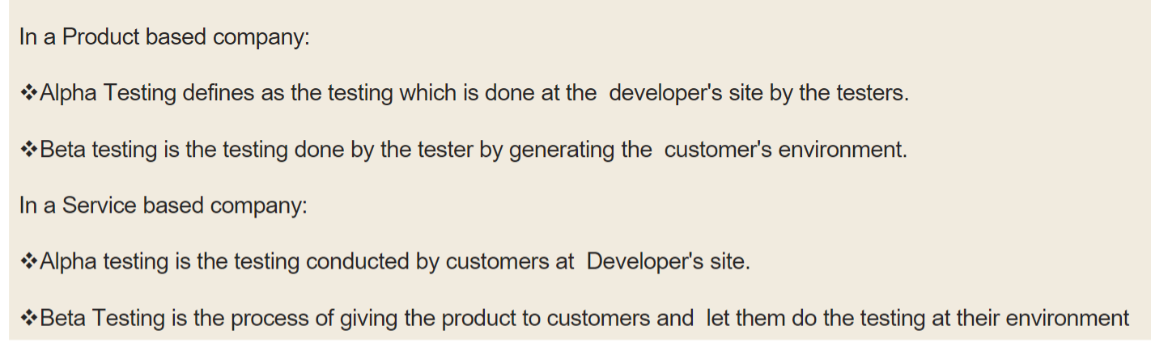
User Acceptance Testing
Two Types of Acceptance Testing
Alpha Testing
Beta Testing

Slide 72
Different Types of Testing
Testing is majorly categorized the following two types
  Function Testing
  Non-Function Testing
Functional Testing
  This type of testing ignores the internal parts and focuses only on the output to check if it is as per the requirement or not. It is a Black-box type testing geared to the functional requirements of an application.
  Non-Functional Testing
    Non-Functional Testing involves testing of non-functional requirements such as Load Testing, Stress Testing, Security, Volume, Recovery Testing, etc. The objective of NFT testing is to ensure whether the response time of software or application is quick enough as per the business requirement.

Slide 73
Different Types of Functional Testing
Different Types of Functional Testing are:
Unit Testing
Integration Testing
Smoke Testing
System Testing
Re-Testing
Sanity Testing
Regression Testing
User Acceptance Testing
Alpha Testing
Beta Testing
Accessibility Testing
Ad hoc / Random / Monkey Testing
Risk Based Testing

Slide 74
Different Types of Non-Functional Testing
There are two types of Non-functional Testing
Performance Testing
Security Testing

Slide 75
Different Types of Performance Testing
Few major types of Performance Testing include:
Load Testing
Stress Testing
Endurance / Longevity Testing
Network Testing
Scalability Testing
Volume Testing
Recovery Testing
Installation Testing
Usability Testing
Compatibility Testing
Reliability Testing

Slide 76
What is Security Testing
Security testing is a type of software testing focused on identifying vulnerabilities, risks, and weaknesses in a system so that malicious users (hackers) cannot exploit them.
In simple terms: It checks how well your application can resist attacks.
Main Goals
Ensure confidentiality (data is only accessible to authorized people).
Maintain integrity (data cannot be changed without permission).
Guarantee availability (systems remain usable even under attack).
Verify authentication and authorization are working correctly.
Prevent data leaks and security breaches.

Slide 77
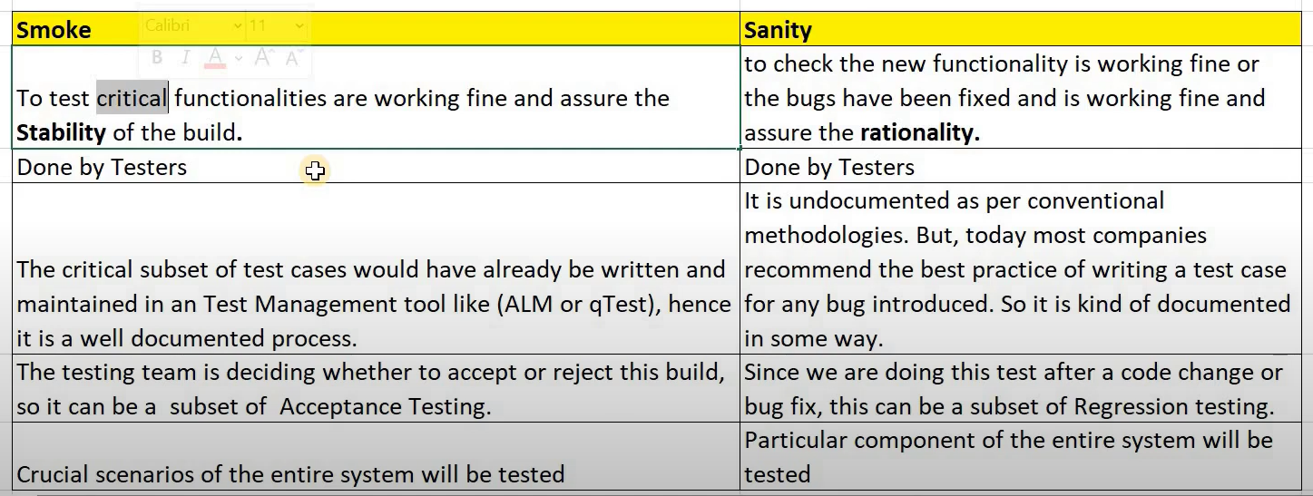
Smoke Testing vs Sanity Testing

Slide 78
Smoke Testing vs Sanity Testing
Smoke testing | Sanity testing
Executed on initial/unstable builds | Performed on stable builds
Verifies the very basic features | Verifies that the bugs have been fixed in the received build and no further issues are introduced
Verify if the software works at all | Verify several specific modules, or the modules impacted by code change
Can be carried out by both testers and developers | Carried out by testers
A subset of acceptance testing | A subset of regression testing
Done when there is a new build | Done after several changes have been made to the previous build

Slide 79
Key Differences
Key Differences:
Scope: Smoke testing has a broader scope, covering all major functionalities, while sanity testing has a narrower scope, focusing on specific areas affected by recent changes.
Purpose: Smoke testing verifies the overall stability of the build, whereas sanity testing validates the stability of specific areas impacted by recent changes.
Execution Timing: Smoke testing is typically performed after receiving a new build or major changes, whereas sanity testing is conducted after minor changes, bug fixes, or enhancements.
Depth of Testing: Smoke testing is more superficial and does not involve in-depth testing, while sanity testing is more detailed and specific to the areas impacted by recent changes.

Slide 80
Retesting vs Regression Testing
Re-Testing | Regression Testing
Re-Testing is done to verify that the defect has been fixed correctly or not | Regression Testing is done to verify the code changes for the defects has not adversely affected the other working functionalities
Re-Testing is done only for failed test cases | Regression Testing is done for passed test cases also
Defect verification is part of Re-Testing | Defect verification is not part of Regression Testing
Test Cases cannot be automated | Test Cases can be automated

Slide 81
Maintenance Testing
Maintenance Testing is done on the already deployed software. The deployed software needs to be enhanced, changed or migrated to other hardware. The Testing done during this enhancement, change and migration cycle is known as maintenance testing.
Once the software is deployed in operational environment it needs some maintenance from time to time in order to avoid system breakdown, most of the banking software systems needs to be operational 24*7*365. So it is very necessary to do maintenance testing of software applications.

Slide 82
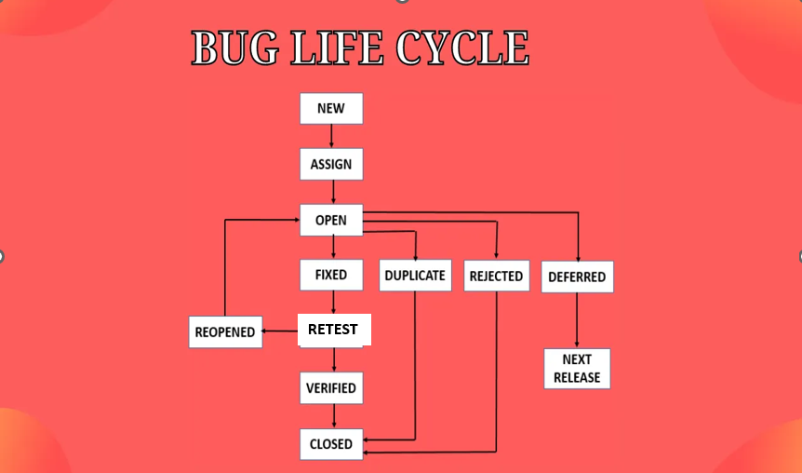
Defect Life Cycle

Slide 83
Error vs Defect vs Bug vs Failure
What is Defect?
Testing is the process of identifying defects, where a defect is any variance between actual and expected results.
“A mistake in coding is called Error,
error found by tester is called Defect,
defect accepted by development team then it is called Bug,
build does not meet the requirements then it Is Failure.

Slide 84
Test Organization
Test Organization in Software Testing is a procedure of defining roles in the testing process. It defines who is responsible for which activities in testing process. Test functions, facilities and activities are also explained in the same process. The competencies and knowledge of the people involved are also defined however everyone is responsible for quality of testing process.
Now you have a Plan, but how will you stick to the plan and execute it? To answer that question, you have Test Organization phase.
Generally speaking, you need to organize an effective Testing Team. You have to assemble a skilled team to run the ever-growing testing engine effectively.

Slide 85
Test Estimation
Software Testing Estimation (STE) can be defined as the management of activity that calculates a rough estimation of how long a task or work or test will take in completing. The estimation effort of testing acts as one of the chiefs and significant tasks for management test.
Factors needed in Estimating Effort for Test:
The complexity of your application needs to be tested.
Proper availability of requirements.
Proper external application linkages.
Previous testing experience.
Specific & domain software knowledge.
Check for the performance of your project & its environment.
Estimate the risks that may occur in application deployment.
The method and technology needed for developing the application.
Tools needed for testing.

Slide 86
Test Estimation
Type of Estimation:
WBS – Work Breakdown Structure
3-Point Estimation Technique
Function Point Analysis
Use Case Point Estimation
Percentage Distribution
Experience-based Testing
Wideband Delphi Technique

Slide 87
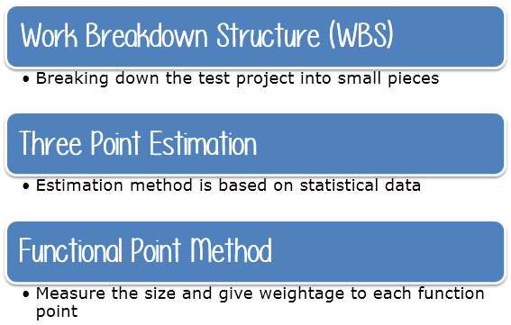
Test Estimation

Slide 88
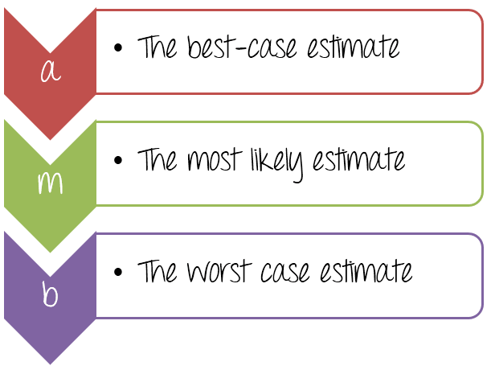
3-Point Estimation

Slide 89
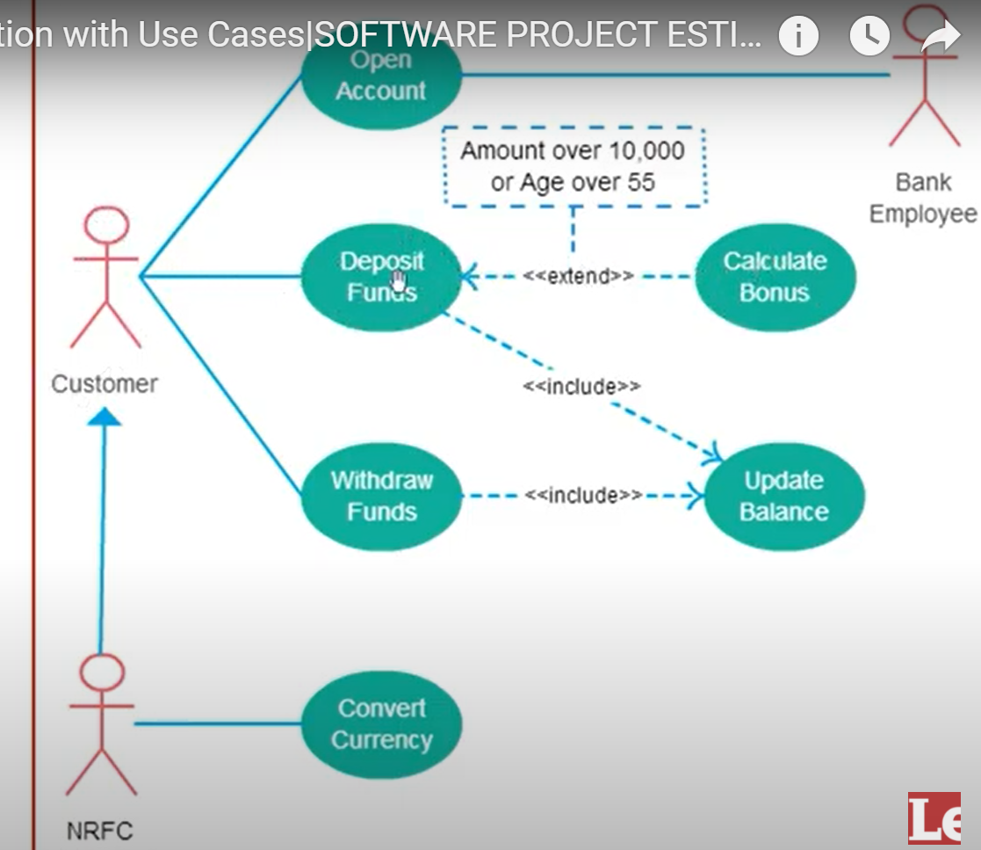
Use Case Point Estimation

Slide 90
Test Strategies
A Test Strategy document is a high level document and normally developed by project manager. This document defines “Software Testing Approach” to achieve testing objectives.
The Test Strategy is normally derived from the Business Requirement Specification document.
The Test Strategy document is a static document meaning that it is not updated too often. It sets the standards for testing processes and activities and other documents such as the Test Plan draws its contents from those standards set in the Test Strategy Document.
Some companies include the “Test Approach” or “Strategy” inside the Test Plan, which is fine and it is usually the case for small projects. However, for larger projects, there is one Test Strategy document and different number of Test Plans for each phase or level of testing.

Slide 91
Test Strategies
Components of the Test Strategy document
Scope and Objectives
Business issues
Roles and responsibilities
Communication and status reporting
Test deliverables
Industry standards to follow
Test automation and tools
Testing measurements and metrices
Risks and mitigation
Defect reporting and tracking
Change and configuration management
Training plan

Slide 92
Test Progress Monitoring and Control
Test progress monitoring
The purpose of test monitoring is to give feedback and visibility about test activities. Information to be monitored may be collected manually or automatically and may be used to measure exit criteria, such as coverage. Metrics may also be used to assess progress against the planned schedule and budget.
Common test metrics include:
Percentage of work done in test case preparation (or percentage of planned test cases prepared).
Percentage of work done in test environment preparation.
Test case execution (e.g. number of test cases run/not run, and test cases passed/failed).
Defect information (e.g. defect density, defects found and fixed, failure rate, and retest results).
Test coverage of requirements, risks or code.
Subjective confidence of testers in the product.
Dates of test milestones.
Testing costs, including the cost compared to the benefit of finding the next defect or to run the next test.

Slide 93
Testing Metrics
Software Testing Metrics are the quantitative measures used to estimate the progress, quality, productivity and health of the software testing process. The goal of software testing metrics is to improve the efficiency and effectiveness in the software testing process
The following are very important testing metrics
% of test cases executed
% of test cases not executed
% of test cases passed
% of test cases failed
% of test cases blocked
Defect Density
Defect Removal Efficiency
Defect Leakage

Slide 94
Testing Metrics
Defects by Severity
Defects by Priority
Few Formulas For Calculating Test Efficiency
Test Efficiency = (Total number of bugs found in unit+integration+system testing) / (Total number of bugs found in unit+integration+system+user acceptance testing)
Testing Efficiency = (Number of bugs resolved / Total No. of bugs raised) * 100
Few Formulas For Calculating Test Effiectiveness
Test Effectiveness = Number of defects found divided by number of test cases executed.
Test Effectiveness = (total number of defects injected +total number of defect found) / (total number of defect escaped)* 100

Slide 95
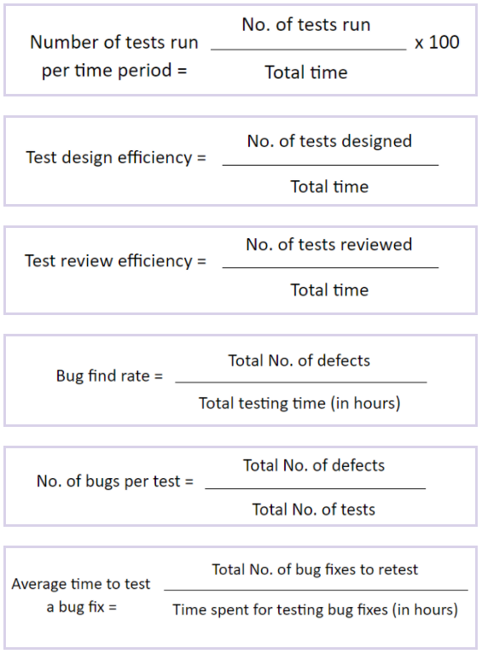
Testing Metrics

Slide 96
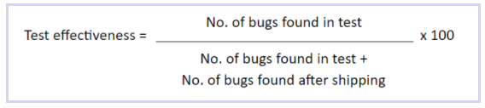
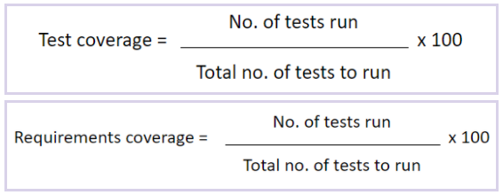
Testing Metrics

Slide 97
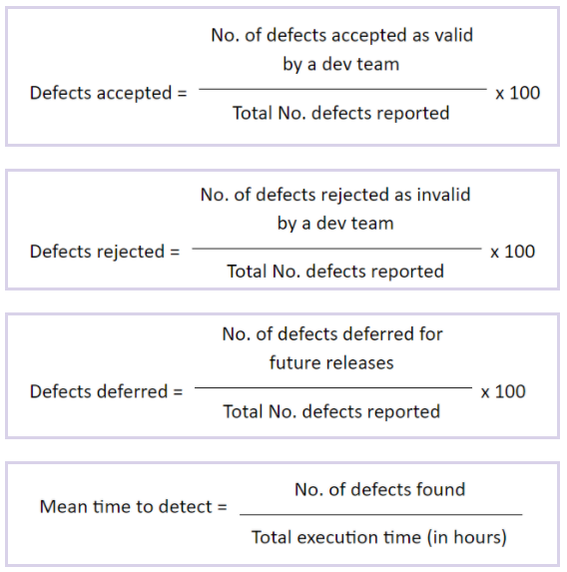
Testing Metrics

Slide 98
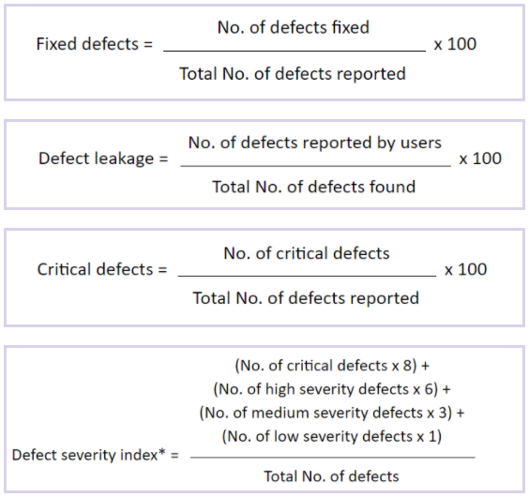
Testing Metrics

Slide 99
Test Case Review
Self Review
Peer Review
Review by Supervisor

Slide 100
Some Common Mistakes…
Spelling mistakes: Sometimes, spelling mistake can create a lot of confusions or make a sentence difficult to understand.
Grammar: If grammar is not proper then test case can be interpreted in a wrong way, resulting in wrong results.
Template format: If proper template is followed then it becomes easy to add/modify test cases in future and test case plan looks organized.
Standard/Guidelines: While review process, it is very important to check whether all the standards and guideline are properly followed.
Language used: Test cases should have a very simple language which is easy to understand.
Functionality coverage: It is highly recommended that all the functionality associated with the system under test should be covered so that major defects are not missed.
Replication: It refers to the duplicate test cases removal. It is possible that two or more test cases test the same thing and can be merged into one, this would save time and space.
Redundancy: It refers to uselessness of a test case due to change in requirements or some modifications. Such test cases must be removed.

Slide 101
Points to remember while reviewing test cases
While reviewing test case, it is better to have a copy of SRS/FRD with you for the reference.
If you are not sure about any test case or expected result, it is better to discuss with the client or your supervisor before making any decision.
If possible then try to execute test cases on the SUT (System Under test) to have a better understanding of the results and execution steps.
It is always better to have a face to face meeting with the tester to make him understand all the review feedback properly.
It is recommended to follow version numbers in review process. For e.g. if you have reviewed a test case plan for the first time then make it v.1, after tester has made all the changes then after the review, the version would be v.1.1. In this way you will have a better idea which one is the latest and also you will have all the record of the changes made to the plan.

Slide 102
Configuration Management
Configuration management is a process for maintaining computer systems, servers, and software in a desired, consistent state. It's a way to make sure that a system performs as it's expected to as changes are made over time.
Configuration management determines clearly about the items that make up the software or system. These items include source code, test scripts, third-party software, hardware, data and both development and test documentation.
Configuration management (CM) is the detailed recording and updating of information that describes an enterprise's computer systems and networks, including all hardware and software components. Such information typically includes the versions and updates that have been applied to installed software packages and the locations and network addresses of hardware devices. Special configuration management software is available. When a system needs hardware or software upgrade, a computer technician can accesses the configuration management program and database to see what is currently installed. The technician can then make a more informed decision about the upgrade needed.

Slide 103
Configuration Management
Configuration management aims to establish consistency in an enterprise. This is attained by continuously updating processes of the organization, maintaining versioning and handling the entire organization network, hardware and software components efficiently.
- Software Configuration management deals with controlling and tracking changes made to the software. This is necessary to allow easy accommodation of changes at any time.

Slide 104
Tools for Configuration Management
The following are the very popular tools for Configuration Management
Puppet
CHEF
Ansible
TeamCity
Octopus

Slide 105
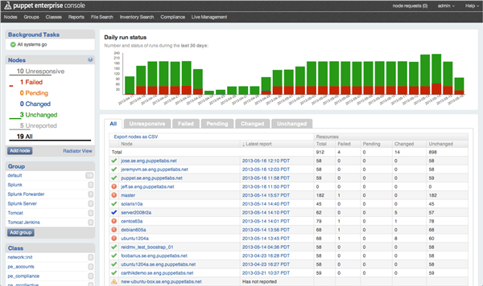
Puppet

Slide 106
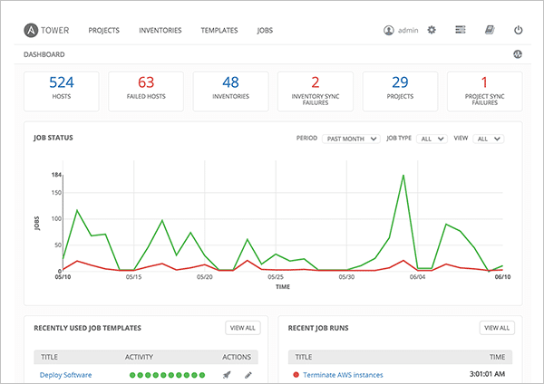
Ansible

Slide 107
Risk and Testing
Risk Based Testing (RBT) is a software testing type which is based on the probability of risk. It involves assessing the risk based on software complexity, criticality of business, frequency of use, possible areas with Defect etc. Risk based testing prioritizes testing of features and functions of the software application which are more impactful and likely to have defects.
Types of Risks:
Positive risks are referred to as opportunities and help in business sustainability. For example investing in a New project, Changing business processes, Developing new products.
Negative Risks are referred to as threats and recommendations to minimize or eliminate them must be implemented for project success.

Slide 108
Risk and Testing
Few Possible Risks in Software Testing:
Tight timelines
Undefined project scope
Insufficient resources
Continuously changing requirements
Natural disasters

Slide 109
Incident Management
What is Incident
Incident in a software testing can be defined as a variation or deviation observed in system behavior from what is expected. It can be a deviation from a functional requirement or from the environment setup. Very often an incident is referred as a defect or a bug, but it is not always the case. Incident is basically any unexpected behavior or response from software that requires investigation. Let’s study the difference between the two to understand better.
Incidents might occur due to misconfiguration, corrupted data, server crashes.
Ex:
Disk Space Full
Service Unavailable
Intermittent Environment Issue
Server Down
Network Error

Slide 110
Incident vs Defect
S.No. | Incident | Defect
1 | Occurrence of any unexpected behavior while testing. | When actual behavior does not match expected behavior.
2 | It might or might not be required to fix it, depending on whether it is a defect or just a mistake or some environmental issue. | It needs to be fixed.

Slide 111
How to write Good Incident Report
The following are very important fields in the incident report
Incident ID
Summary
Description
Test Data
Severity
Priority
Steps Used
Expected Results
Actual Result
Assigned to
Proof

Slide 112
Tools for Managing Incidents
The following are very popular tools for managing incidents
JIRA
HP ALM / QC
Bugzilla
IBM Rational Clear Quest
BugHost

Slide 113
Types of Testing Tool
Test Management Tool
Automated Testing Tools
Cross-browser Testing Tools
Load Testing Tools
Defect Tracking Tools
Mobile Testing Tools
API Testing Tools
Security Testing Tools
CSS Validator Tool

Slide 114
Test Management Model
JIRA
TestRail
Testpad
Xray
Practitest
TestMonitor

Slide 115
Automated Testing Tools
Selenium
UFT
Watir
TestComplete

Slide 116
Cross-browser Testing Tools
LambdaTest
Browsera
CrossBrowser Testing
SauceLabs
Ghostlab
Browsershots

Slide 117
Load Testing Tools
LoadRunner
Jmeter
WebLoad
Silk Performer
Agileload
Loadfocus
BlazeMeter
LoadImpact

Slide 118
Defect Tracking Tools
JIRA
HP ALM
Bugzilla
BugHost

Slide 119
Mobile Testing Tools
Appium
Espresso
Perfecto
ExperiTest
Robotium

Slide 120
API Testing Tools
SoapUI
Postman
SoapSonar
WebInect
Tricentis

Slide 121
Security Testing Tools
NetSparker
OWASP

Slide 122
CSS Validator Tool
W3C CSS Validator
Telerik studio

Slide 123
Effective use of tools
Functional Testing Tools
Selenium
UFT
Performance Testing Tools
LoadRunner
JMeter

Slide 124
Introducing a tool into an organization
State the main principles of introducing a tool into an organization (K1)
The organization must be ready to introduce, use and be involved in adapting the tool through its test processes: only an assessment of the organizational maturity could prove its readiness by clearly identifying the strengths, weaknesses and opportunities to do so.
Essentially, the assessment should identify which testing area or processes can be improved by adopting the tool.
State the goals of a proof-of-concept for tool evaluation and a piloting phase for tool implementation (K1)
During test tool evaluation phase, we should identify whether:
- it performs effectively within the software under test and within the current infrastructure.
- it requires any potential changes.

Slide 125
Introducing a tool into an organization
We should also evaluate the vendor (support, version, reference site visit, training), evaluate internal requirements such as training needed and estimate a cost-benefit ratio based on a concrete business case.
Once the assessment done and the decision to introduce this tool is made, a pilot should be planned for learning more details, confirming that our assumptions were justified (costs involved, benefits, changes identified) and mastering its use before further roll out.

Slide 126
Introducing a tool into an organization
Recognize that factors other than simply acquiring a tool are required for good tool support (K1)
For successfully deploying a tool within an organisation, the initiative should always follow these principles:
roll out the tool to the rest of the organization incrementally.
adapt and improve processes to fit accordingly to how the tool should be used.
provide training and coaching/mentoring for new users.
define usage guidelines.
implement way to gather usage information.
monitor tool use and benefits.
provide support to the test team.
gather lessons learned from all teams.

